Slide 1

LO1-Understanding of disease and ill-health
Public Health Week 3

Slide 2


Slide 3

Aim;
LO1- Develops an understanding of disease and ill-health and the underlying principles behind inequalities in health.
Learning Outcomes;
Explore the Concepts of disease
Develop an understanding of ill-health and their determinants
Created by Tayo Alebiosu

Slide 4
Activity (10 minutes)
Research the meaning of Public health
Feedback to the class
Health of a population as whole
Hygiene and epidemiology and disease prevention
Improving the health of the community, prevention

Slide 5
Public health is a multi-disciplinary field that aims to:
Prevent disease and death,
Promote a better quality of life, and
Create environmental conditions in which people can be healthy by intervening at the institutional, community, and societal level.
Whether public health practitioners can achieve this mission depends upon their ability to accurately identify and define public health problems, assess the fundamental causes of these problems, determine populations most at-risk, develop and implement theory-
and evidence-based interventions, and evaluate and refine those interventions to ensure that they are achieving their desired outcomes without unwanted negative consequences.

Slide 6
To be effective in these endeavors, public health practitioners must know how to apply the basic principles, theories, research findings, and methods of the social and behavioral sciences to inform their efforts.
A thorough understanding of theories used in public health, which are mainly derived from the social and behavioral sciences, allow practitioners to:
Assess the fundamental causes of a public health problem, and
Develop interventions to address those problems.

Slide 7
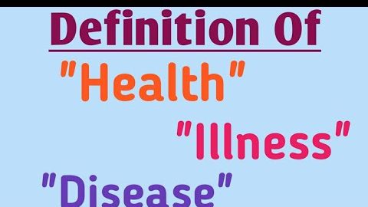

Slide 8
What exactly is a disease?
Negatively affect the part of an organism
Disorder of a structure Or function of a human
Abnormal condition

Slide 9
https://youtu.be/thAyrNpD77A
In this video we look at how to describe the terms health and disease, the difference between communicable and non-communicable disease, and how diseases can interact.

Slide 10
A simple definition of disease is an “illness or sickness characterised by specific signs or symptoms”.
But it is interesting that some dictionaries suggest that diseases are caused by “bacteria or infections”, seemingly dismissing psychological and noncommunicable conditions as diseases, which is odd given that noncommunicable diseases, such as cardiovascular disease and cancer, make up most ill health in the world today.

Slide 11
A disease is a particular abnormal condition that negatively affects the structure or function of all or part of an organism, and that is not due to any immediate external injury.
Diseases are often known to be medical conditions that are associated with specific signs and symptoms.
A disease may be caused by external factors such as pathogens or by internal dysfunctions.
For example, internal dysfunctions of the immune system can produce a variety of different diseases, including various forms of immunodeficiency, hypersensitivity, allergies and autoimmune disorders.

Slide 12
In humans, disease is often used more broadly to refer to any condition that causes pain, dysfunction, distress, social problems, or death to the person afflicted, or similar problems for those in contact with the person.
In this broader sense, it sometimes includes injuries, disabilities, disorders, syndromes, infections, isolated symptoms, deviant behaviors, and atypical variations of structure and function, while in other contexts and for other purposes these may be considered distinguishable categories.
Diseases can affect people not only physically, but also mentally, as contracting and living with a disease can alter the affected person's perspective on life.

Slide 13
Types of disease
Acquired disease
An acquired disease is one that began at some point during one's lifetime, as opposed to disease that was already present at birth, which is congenital disease. Acquired sounds like it could mean "caught via contagion", but it simply means acquired sometime after birth. It also sounds like it could imply secondary disease, but acquired disease can be primary disease.
Acute disease
An acute disease is one of a short-term nature (acute); the term sometimes also connotes a fulminant nature

Slide 14
Primary disease
A primary disease is a disease that is due to a root cause of illness, as opposed to secondary disease, which is a sequela, or complication that is caused by the primary disease.
For example, a common cold is a primary disease, where rhinitis is a possible secondary disease, or sequela. A doctor must determine what primary disease, a cold or bacterial infection, is causing a patient's secondary rhinitis when deciding whether or not to prescribe antibiotics.

Slide 15
Secondary disease
A secondary disease is a disease that is a sequela or complication of a prior, causal disease, which is referred to as the primary disease or simply the underlying cause (root cause).
For example, a bacterial infection can be primary, wherein a healthy person is exposed to bacteria and becomes infected, or it can be secondary to a primary cause, that predisposes the body to infection.
For example, a primary viral infection that weakens the immune system could lead to a secondary bacterial infection. Similarly, a primary burn that creates an open wound could provide an entry point for bacteria, and lead to a secondary bacterial infection.

Slide 16
Congenital disorder or congenital disease
A congenital disorder is one that is present at birth. It is often a genetic disease or disorder and can be inherited. It can also be the result of a vertically transmitted infection from the mother to the child , such as HIV/AIDS.
Genetic disease
A genetic disorder or disease is caused by one or more genetic mutations. It is often inherited, but some mutations are random and de novo.
Hereditary or inherited disease
A hereditary disease is a type of genetic disease caused by genetic mutations that are hereditary (and can run in families)

Slide 17
Incurable disease
A disease that cannot be cured. Incurable diseases are not necessarily terminal diseases, and sometimes a disease's symptoms can be treated sufficiently for the disease to have little or no impact on quality of life of an affected individual.

Slide 18
Chronic Diseases and Conditions
Chronic condition or chronic disease
A chronic disease is one that persists over time, often characterized as at least six months but may also include illnesses that are expected to last for the entirety of one's natural life.
Chronic diseases - such as heart disease, cancer, diabetes, stroke, and arthritis - are the leading causes of disability and death. Although common and costly, many chronic diseases are also preventable.

Slide 19
Many chronic diseases are linked to lifestyle choices that are within your own hands to change.
Eating nutritious foods, becoming more physically active and avoiding tobacco can help keep you from developing many of these diseases and conditions.
And, even if you already have diabetes, heart disease, arthritis or another chronic condition, eating more healthful food and getting more exercise, whether it's a brisk walk, a bike ride, a jog or a swim, can help you better manage your illness, avoid complications and prolong your life.

Slide 20
Terminal disease
A terminal disease is one that is expected to have the inevitable result of death.
Previously, AIDS was a terminal disease; it is now incurable, but can be managed indefinitely using medications.

Slide 21
Communicable diseases, also known as infectious diseases or transmissible diseases, are illnesses that result from the infection, presence and growth of pathogenic (capable of causing disease) biologic agents in an individual human or other animal host.
Examples of communicable disease
Some examples of the communicable disease include HIV, hepatitis A, B and C, measles, salmonella, and blood-borne illnesses.
Most common forms of spread through food, sexual intercourse, insect bites, contact with contaminated fomites, droplets, or skin contact.

Slide 22
Non-communicable
A non-communicable disease is a medical condition or disease that is non-transmissible. Non-communicable diseases cannot be spread directly from one person to another. Heart disease and cancer are examples of non-communicable diseases in humans.
A non-communicable disease (NCD) is a disease that is not transmissible directly from one person to another.
NCDs examples include: Parkinson's disease, autoimmune diseases, strokes, most heart diseases, most cancers, diabetes, chronic kidney disease, osteoarthritis, osteoporosis, Alzheimer's disease, cataracts, and others.

Slide 23
Activity
There is an ongoing lively debate among healthcare professionals about whether or not obesity is a disease.
Is obesity a disease or not?

Slide 24
Activity-cont….
Differences between those who argue that it’s a disease and those who argue that it’s just a risk factor for conditions such as type 2 diabetes and heart disease are unlikely to be resolved any time soon.
The debate, however, raises other questions, such as, what exactly is a disease and who gets to decide?

Slide 25
Disorder
A disorder is a functional abnormality or disturbance. Medical disorders can be categorized into mental disorders, physical disorders, genetic disorders, emotional and behavioral disorders, and functional disorders.
The term disorder is often considered more value-neutral and less stigmatizing than the terms disease or illness, and therefore is preferred terminology in some circumstances.
In mental health, the term mental disorder is used as a way of acknowledging the complex interaction of biological, social, and psychological factors in psychiatric conditions; however, the term disorder is also used in many other areas of medicine, primarily to identify physical disorders that are not caused by infectious organisms, such as metabolic disorders.

Slide 26
Infectious
Infectious diseases, also known as transmissible diseases or communicable diseases, comprise clinically evident illness (i.e., characteristic medical signs or symptoms of disease) resulting from the infection, presence and growth of pathogenic biological agents in an individual host organism.
Included in this category are contagious diseases – an infection, such as influenza or the common cold, that commonly spreads from one person to another – and communicable diseases – a disease that can spread from one person to another, but does not necessarily spread through everyday contact.

Slide 27
For example, a person who feels unwell as a result of embarrassment, and who interprets those feelings as sickness rather than normal emotions). Symptoms of illness are often not directly the result of infection, but a collection of evolved responses
– sickness behavior by the body
– that helps clear infection and promote recovery. Such aspects of illness can include lethargy, depression, loss of appetite, sleepiness, hyperalgesia, and inability to concentrate

Slide 28
Lifestyle
A lifestyle disease is any disease that appears to increase in frequency as countries become more industrialized and people live longer, especially if the risk factors include behavioral choices like a sedentary lifestyle or a diet high in unhealthful foods such as refined carbohydrates, trans fats, or alcoholic beverages.

Slide 29

Epidemiology

Slide 30
Epidemiology is the study and analysis of the distribution, patterns and determinants of health and disease conditions in defined populations. It is a cornerstone of public health, and shapes policy decisions and evidence-based practice by identifying risk factors for disease and targets for preventive healthcare.

Slide 31
Epidemiology
Epidemiology is the study of how often diseases occur in different groups of people and why. Epidemiological information is used to plan and evaluate strategies to prevent illness and as a guide to the management of patients in whom disease has already developed.
Epidemiology identifies the distribution of diseases, factors underlying their source and cause, and methods for their control; this requires an understanding of how political, social and scientific factors intersect to exacerbate disease risk, which makes epidemiology a unique science.
Increasingly, epidemiology is the key to understanding the impact of climate change on disease burden through the effect of temperature, humidity and seasonality on infectious disease dynamics, and the expansion of the ranges of disease vectors.

Slide 32
A key feature of epidemiology is the measurement of disease outcomes in relation to a population at risk. The population at risk is the group of people, healthy or sick, who would be counted as cases if they had the disease being studied.
For example, if a general practitioner were measuring how often patients consult him about deafness, the population at risk would comprise those people on his list (and perhaps also of his partners) who might see him about a hearing problem if they had one.
Patients who, though still on the list, had moved to another area would not consult that doctor. They would therefore not belong to the population at risk.

Slide 33
While the exact number of people whose lives have been saved by epidemiological research may not be possible to calculate, its importance in enhancing life quality and longevity cannot be overlooked.
There are tangible results from epidemiological research. It is unquestionable that the discipline has saved millions of lives, from both infectious and non-communicable diseases, through interventions and preventative programs that have been implemented as a result of study findings.

Slide 34
Epidemiology continues to be at the forefront of saving lives today through forecasting epidemics and pandemics, and identifying diseases likely to cause outbreaks in the future and implementing forward-planning, targeted and collaborative interventions to minimise fatalities
Along with increased inequality, and urbanisation, climate change presents new challenges for global health programmes; in light of these, epidemiological research is sure to remain a cornerstone in guiding public health policies in the near future.

Slide 35
Epidemiology is the study of the factors that cause or encourage diseases. Some diseases are more common in certain geographic areas, among people with certain genetic or socioeconomic characteristics, or at different times of the year.
. Epidemiology can help identify causes as well as guide prevention efforts.
Epidemiology is considered a cornerstone methodology of public health research and is highly regarded in evidence-based medicine for identifying risk factors for diseases. In the study of communicable and non-communicable diseases, the work of epidemiologists ranges from outbreak investigation to study design, data collection, and analysis including the development of statistical models to test hypotheses and the documentation of results for submission to peer-reviewed journals. Epidemiologists also study the interaction of diseases in a population, a condition known as a syndemic.

Slide 36
Chronic Diseases and Conditions
Alzheimer's Disease and other Dementias
Arthritis
Asthma
Cancer
Chronic Obstructive Pulmonary Disease (COPD)
Cystic Fibrosis
Diabetes
Eating Disorders
Heart Disease
Obesity
Oral Health
Osteoporosis
Reflex Sympathetic Dystrophy (RSD) Syndrome
Tobacco Use and Related Conditions

Slide 37
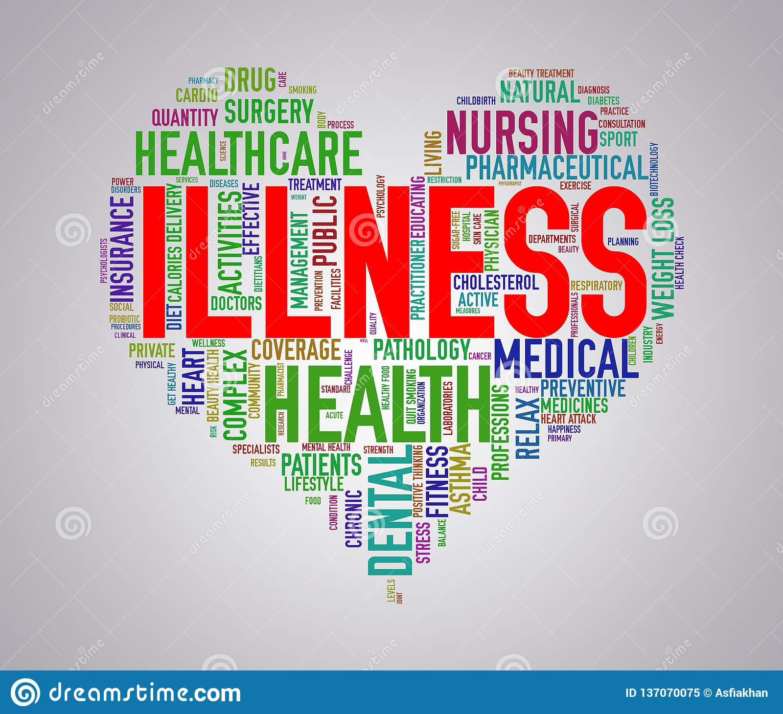
What are the concepts of illness?

Slide 38
Illness is defined as the ill health the person identifies themselves with, often based on self reported mental or physical symptoms. In some cases this may mean only minor or temporary problems, but in other cases self reported illness might include severe health problems or acute suffering.
Illness
The terms illness and sickness are both generally used as synonyms for disease; however, the term illness is occasionally used to refer specifically to the patient's personal experience of his or her disease.
In this model, it is possible for a person to have a disease without being ill (to have an objectively definable, but asymptomatic, medical condition, such as a subclinical infection, or to have a clinically apparent physical impairment but not feel sick or distressed by it), and to be ill without being diseased (such as when a person perceives a normal experience as a medical condition, or medicalizes a non-disease situation in his or her life –

Slide 39
Illness is defined as the ill health the person identifies themselves with, often based on self reported mental or physical symptoms. In some cases this may mean only minor or temporary problems, but in other cases self reported illness might include severe health problems or acute suffering.
What is illness concept?
Illness is defined as the ill health the person identifies themselves with, often based on self reported mental or physical symptoms. In some cases this may mean only minor or temporary problems, but in other cases self reported illness might include severe health problems or acute suffering.

Slide 40
What is impact of illness?
When serious illness or disability strikes a person, the family as a whole is affected by the disease process and by the entire health care experience. Patients and families have different needs for education and counseling.
What is difference between disease and illness?
In layman's terms, an illness is basically termed as an unwell or unhealthy state of mind or body. Disease falls under an entirely different classification. A disease is defined as suffering from a malfunctioning organism or function within the body itself.

Slide 41
What are the different sickness.
Illness and disease,

Slide 42
Definitions of sickness, illness and disease
Although the terms are often used interchangeably, sickness, illness and disease have different meanings that reflect different perspectives.
Disease is an objective term referring to diagnosable abnormalities in organs, body systems or physiology.
Illness is a subjective term referring to an individual’s experience of mental and physical sensations or states, and may not necessarily indicate the presence of disease. Sickness encompasses both disease and illness.

Slide 43
The difference between illness and disease was summarised by Cassell (1976): “Illness is what the patient feels when he goes to the doctor, disease is what he has on the way home”
The view of illness as a social role is based on the premise that the behaviour of patients, doctors and carers is related to social perceptions or constructs of sickness.

Slide 44
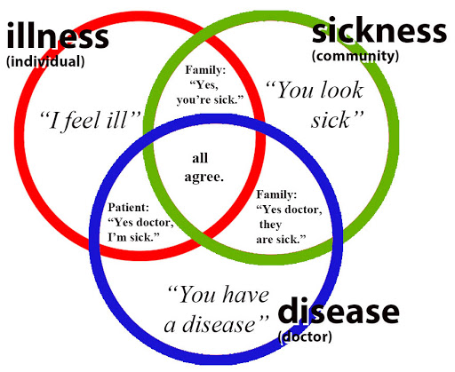

Slide 45
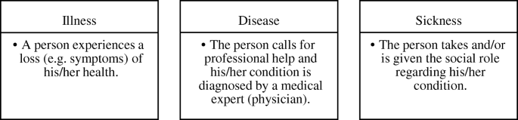

Slide 46
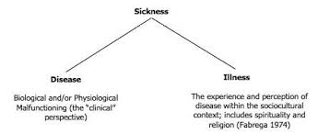

Slide 47
Determinants of health: Nutrition, lifestyle, environment, and genetics are considered as core determinants and four pillars of health. When any one or more of these is compromised, health is at risk and medical care is required as a support system.

Slide 48
https://www.healthknowledge.org.uk/public-health-textbook/medical-sociology-policy-economics/4a-concepts-health-illness/section2
Branas, C. The future of epidemiology: world class science, real world impact. https://www.mailman.columbia.edu/become-student/departments/epidemiology/who-we-are/message-chair/future-epidemiology-world-class-science-real-world-impact
https://www.bmj.com/about-bmj/resources-readers/publications/epidemiology-uninitiated/1-what-epidemiology

